Slide 1
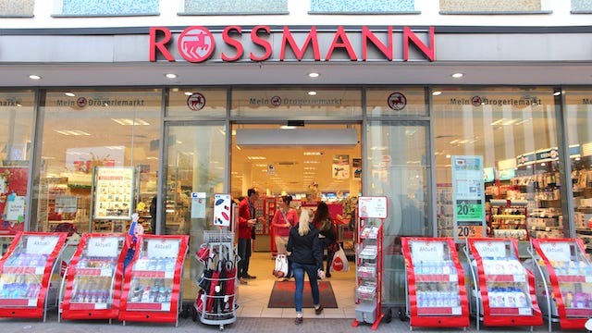
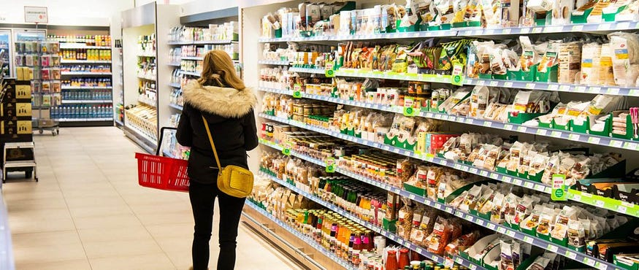
End-to-End Sales Prediction Solution for Retail Stores
Debasis Panda
Batch-VI

Slide 2
Case Study Case Flow
Objective of the Case
Customer Purchasing Behavior Analysis
Sales Prediction Based on Machine Learning Models
Deep Learning LSTM Model
Post Prediction Analysis
Model Serialization
Web Bases Prediction Service
Conclusion

Slide 3
Objective of the Case
• Analyze customer purchasing behavior.
• Predict daily sales up to six weeks ahead.
• Use machine learning and deep learning approaches for forecasting.
• Deploy a web-based tool to serve predictions to finance analysts.

Slide 4
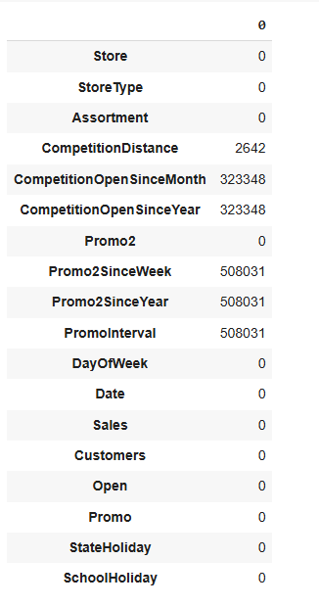

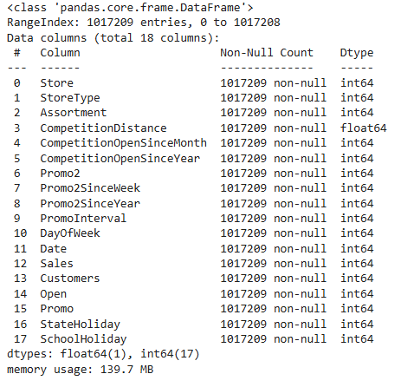
Exploratory Data Analysis (EDA)
Null Values in Data Set
Shape of Data Set Post Merge
Label Encoder
Interpretation
There are null values in CompetitionDistance,CompetitionOpenSinceMonth,CompetitionOpenSinceYear, Promo2SinceWeek,Promo2SinceYear,PromoInterval
The Null values of the object Type Parameters were replaced by Mode and the Integer, Float type were replaced by Median in the distribution
Null values for the Date Type parameters were filled by Unknown
Label Encoder has been applied and Data Types were converted to Integer and Float Types

Slide 5
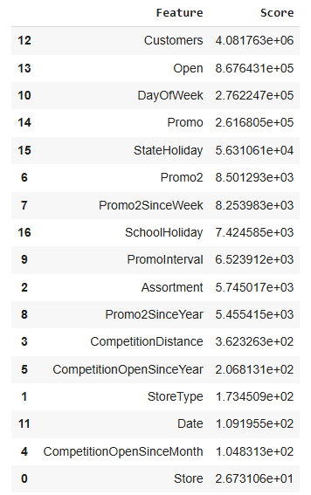
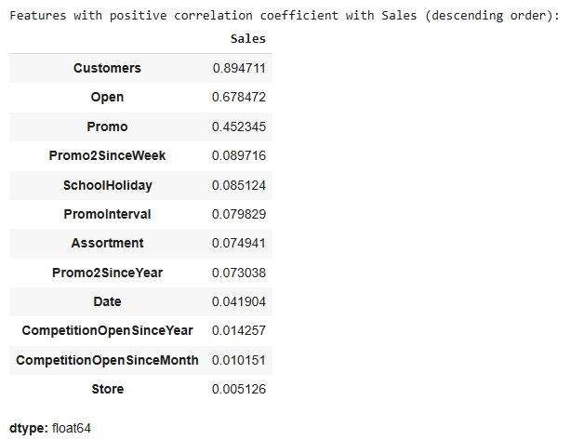
Correlation and Feature Extraction
Fig-1
Fig-2
Interpretation:
Features “Customer “ and “Open” are having maximum positive correlation with Sales , followed by Promo
“Store” and “CompetitionOpen” are having least relation with Sales

Slide 6
Customer Purchasing Behavior Analysis
o Compare the distribution of promotions across training and test sets.
o Analyze sales trends before, during, and after holidays.
o Investigate seasonal purchasing patterns (e.g., Christmas, Easter).
o Assess correlations between sales and customer numbers.
o Evaluate the impact of promotions on customer behavior.
o Examine trends of sales based on store opening/closing times.
o Determine the effect of competitor distance on store sales.
o Explore how assortment types influence sales.

Slide 7
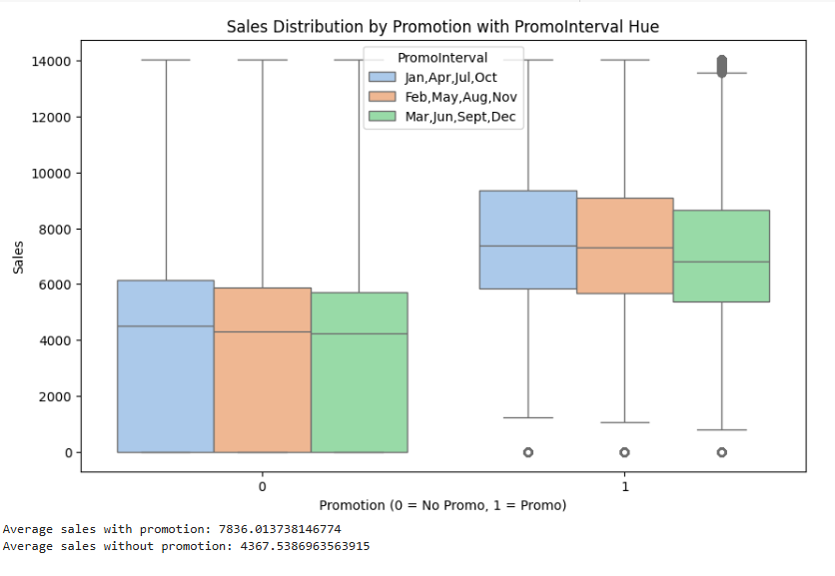
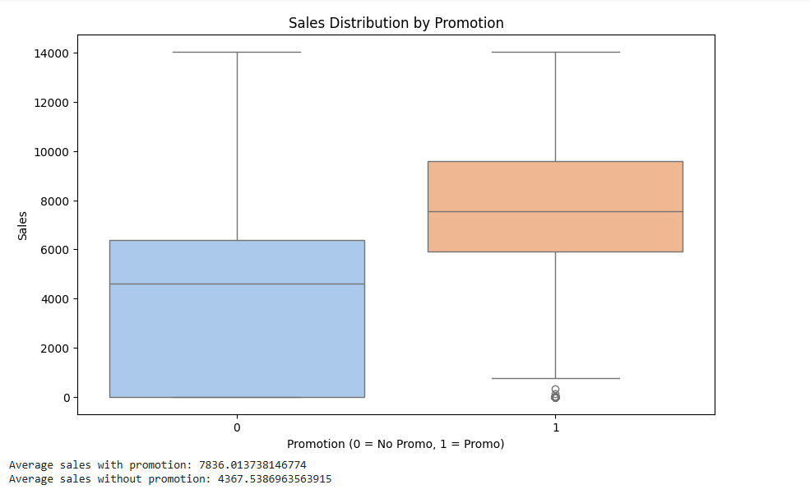
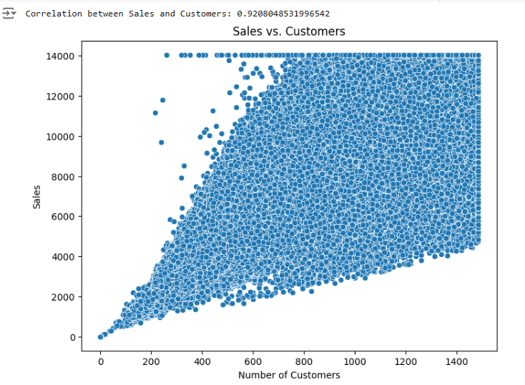
Out Lier Treatment
Sales is significantly impacted by Promotion
There is Average sales of 7836 unit with promotion and without promotion the average sales is 4367 unit
Number of customer visits are having a significant impact on sales, the more it is the more is the sales

Slide 8
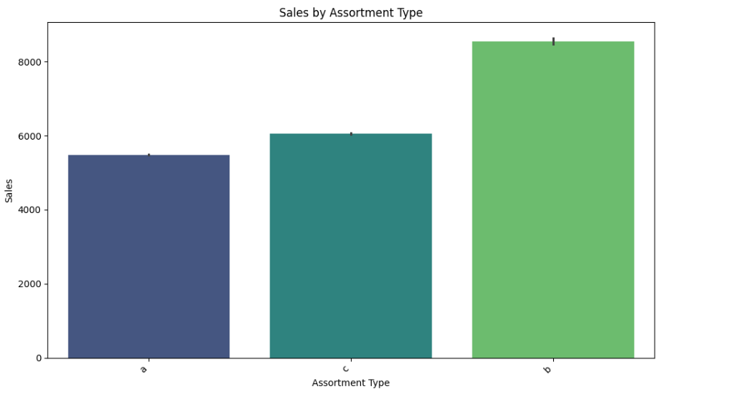
Store Type “B” has got the maximum sales

Slide 9
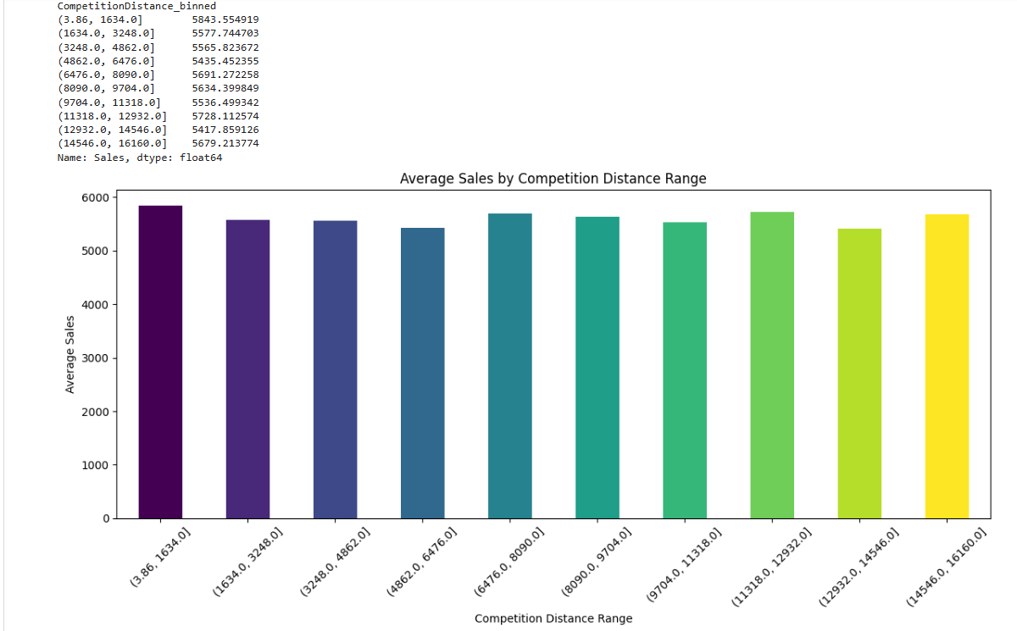
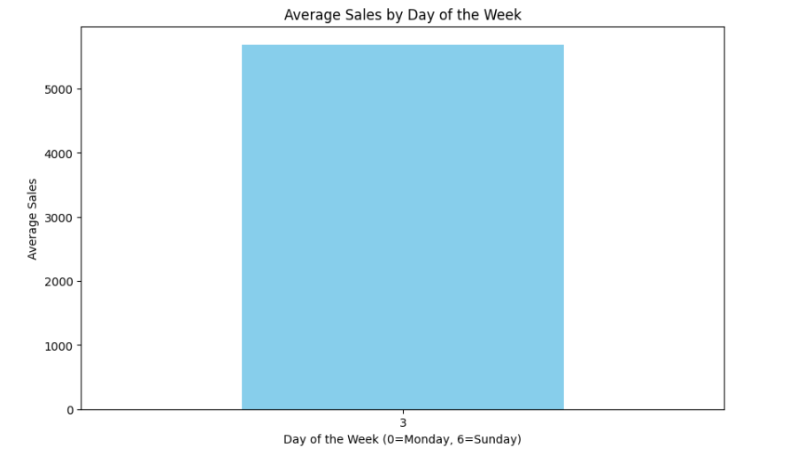
Competition Distance and Sales
Fig-2
Fig-1
Interpretation
Shortest the distance higher is the sales
Highest sales lies in a distance binned between 3.86 to 1634
Lowest Sales of 5417.89 lies at a distance binned between 12932 and 14546
Fig-2 Indicates Average sales of close to 5.5k units by the 3rd day of week

Slide 10
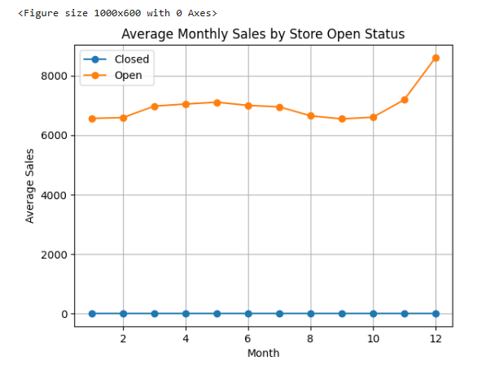
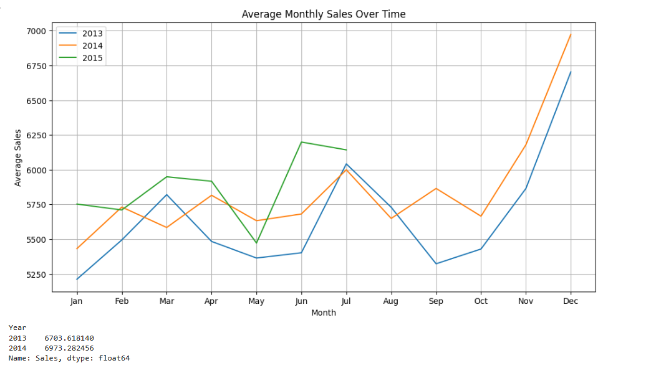
Investigate Seasonal Purchasing Patterns (e.g., Christmas, Easter).
Interpretation:
Store Opening has got a significant impact on Sales
December time , holiday or Christmas Time sales are at all time high for the Years 2013 and 2014, compared to other months of the Year

Slide 11
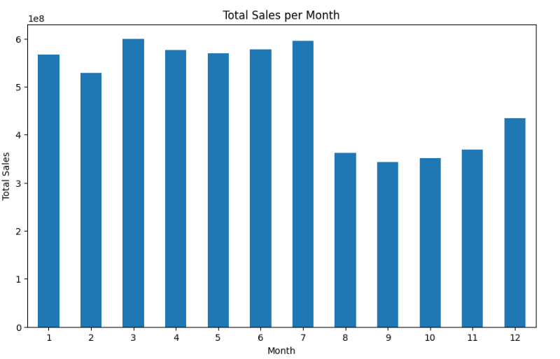
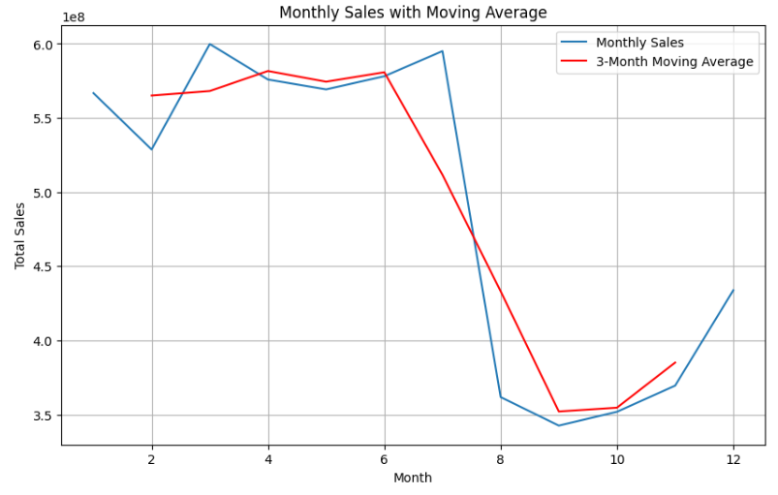
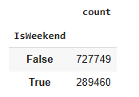

Average Monthly Sales During Holiday and Non Holiday Months
Interpretation:
Weekend(DayofWeek>5) and Weekday(DayofWeek<5) have been created
72% of the data is from Week Day and 28% is from Week End

Slide 12
Task 2: Sales Prediction Objective: Build a robust predictive pipeline using machine learning and deep learning methods.
Sub-Tasks: 1. Preprocessing: o Convert categorical to numeric data. o Handle missing values and scale data. o Generate additional features, e.g., weekdays, weekends, days to/from holidays.
2. Machine Learning Models with Scikit-learn Pipelines: o Begin with tree-based regressors (e.g., Random Forest). o Utilize modular pipelines for efficient workflows. o Choose and justify an appropriate loss function.

Slide 13

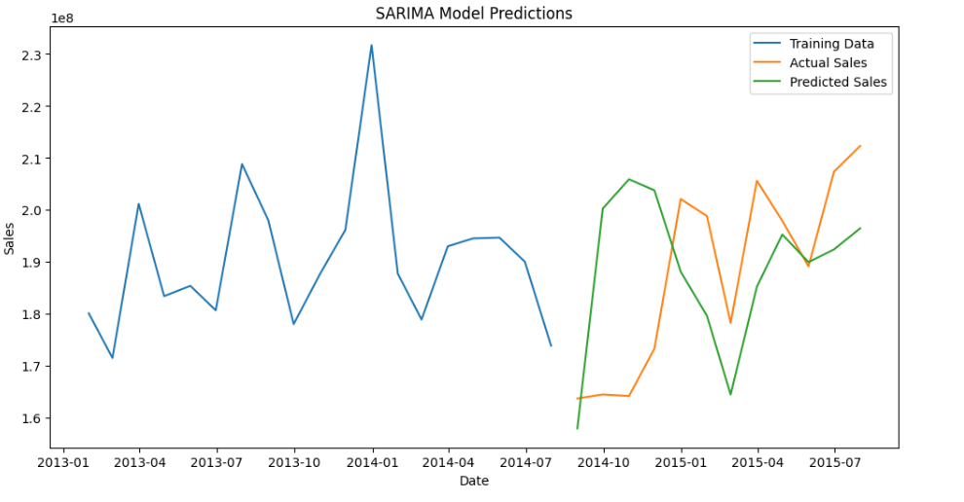
XGBoost MODEL
SARIMA MODEL
Interpretation:
Depending on the importance of the parameters on sales , following features have been identified ['Customers', 'Open', 'Promo', 'SchoolHoliday', 'PromoInterval', 'Assortment','StoreType','CompetitionDistance','Promo2SinceWeek']
XGBoost has been used and the model has been trained using X_train,y_train
The model score or R2 score value for the Y_test and Y_pred have been found for XgBoost model was found to be .95 and RMSE was 798.86
Interpretation
SARIMA model ,has been used to train the data set on a quarterly basis.
It is used in time series data for Forecasting. data with seasonal patterns.
This model has been used as it captures both short term and long term dependencies in data
Using ARIMA model, the RMSE was found to be 2656.92

Slide 14

Random Forest Model Deployment and the Forecast with Deployment
Interpretation:
Above features are having maximum influence on Sales
The root Mean square error of the Model was 746.85
The accuracy of the Model was Found to be 0.96
For the first 10IDS of Test Data , Sales have been predicted using Random Forest Model
Predict Sales for next 42 Days

Slide 15
LSTM Model Building
3. Deep Learning Model:
o Build an LSTM regression model for time series data.
o Steps include:
▪ Stationarity checks.
▪ Data transformation using sliding windows.
▪ Scaling data (-1, 1 range).
▪ Designing a 2-layer LSTM architecture.
Interpretation:
For the Time series Based Data RNN based 2 layer Long Short Memory Model architecture has been used
Using Augmented Dickey-Fuller Test, the stationarity of the data set has been checked and has been made Stationary
For the Input Layer, data has been reshaped and 50 neurons have been passed with relu activation function
Model has been compiled using Adam optimized and Mean Square Error loss function
Model has been trained with a batch size of 32 and epochs of 50
The accuracy of the model has been found

Slide 16
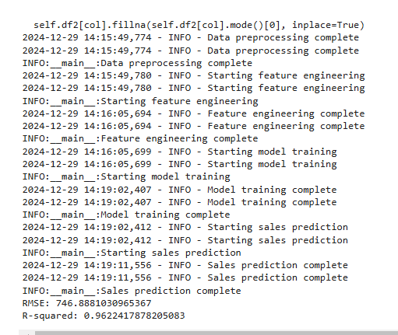
Logger File and Modular Pipe Line Building
Logger File has been used to streamline the process flow from data loading to model building, it has been saved in app.log file
Modular pipe line has been developed to sequentially build the project flow
Below is the ouput of the log and pipeline operation

Slide 17
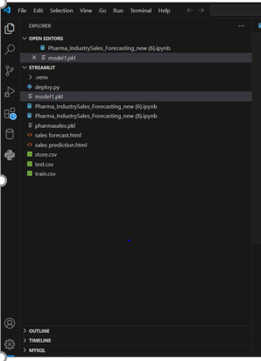
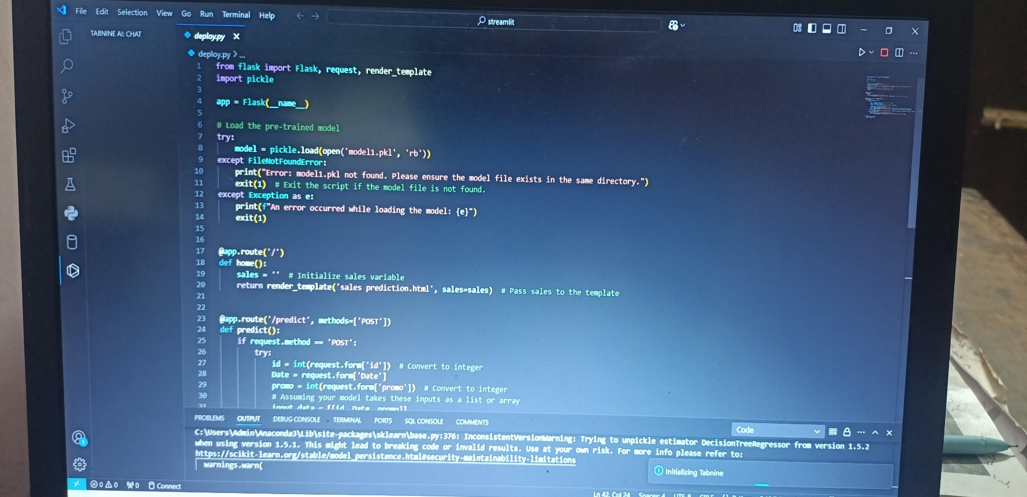
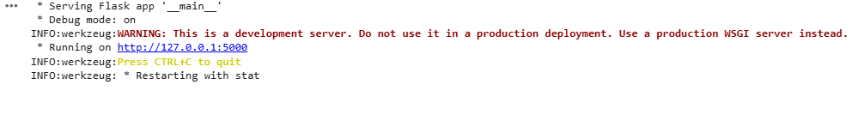
Web-Based Prediction Service Objective: Build and deploy an interactive web interface for making predictions. Requirements: ** 1. Frontend & Backend ** o Use frameworks like Flask or Streamlit

Slide 18
Conclusion
Promotion is having significant impact on sales
More the distance the competitor less is the sales
Random Forest Model performs better compared to XGBoost and LSTM models
Model Serialization(.pkl) file supports in saving the model and its parameters and accessing it later
ARIMA AND SARIMA models prove to be beneficial in finding the stationarity on the data set
Logger file and Pipeline was build to smoothen the execution flow of the project
Serialization was implemented with (Store id, Date and Promo) to predict sales and sales.html webfile was generated
Also Based on Random Forest Model , Sales forecast for first 10 IDS were found
From the last date of the data set , for next 42 days sales were predicted and saved in salespredict.csv file

